Slide 1



Monday, May 10th 2023
Unit
Facebook : Bùi Liễu
0968142780
8
My favourite subjects
Lesson 2

Slide 2
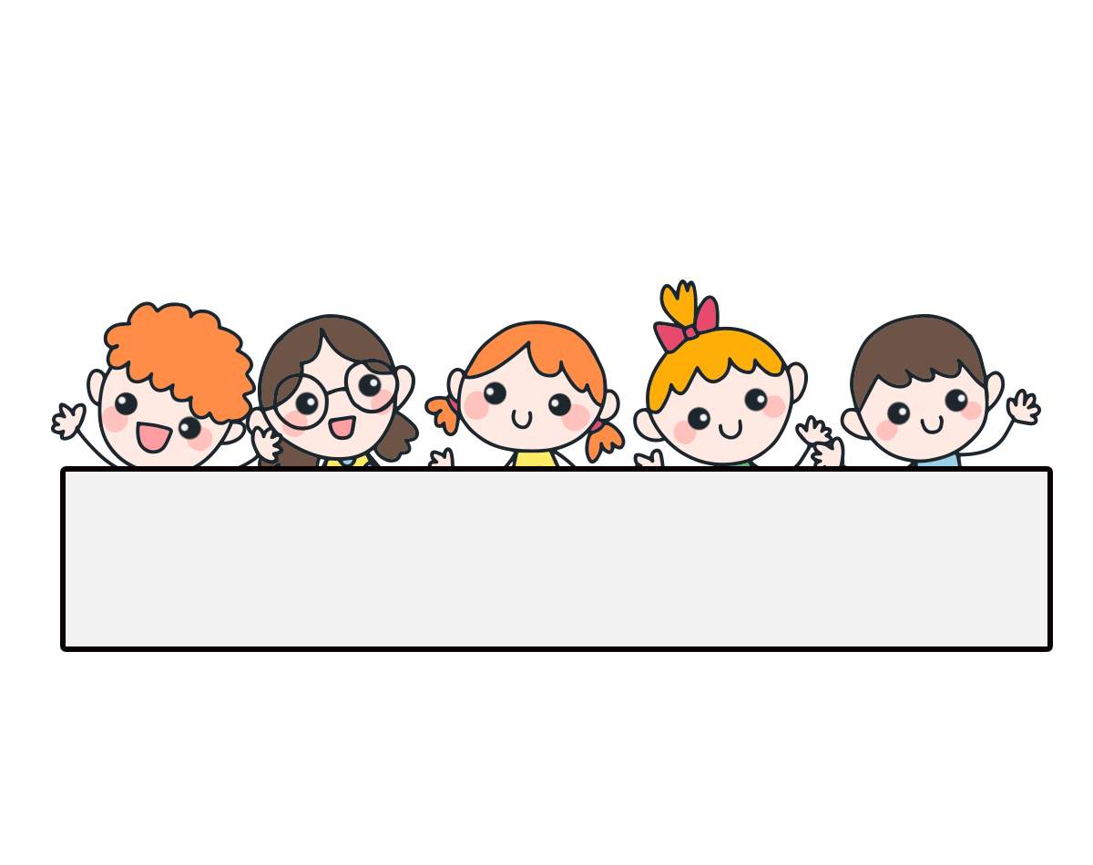
Warm-up

Slide 3

Facebook : Bùi Liễu
0968142780
Let’s play!

Slide 4







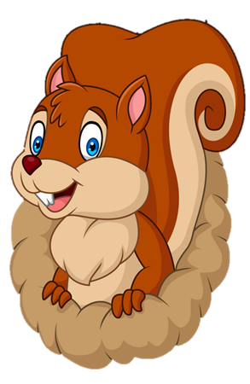
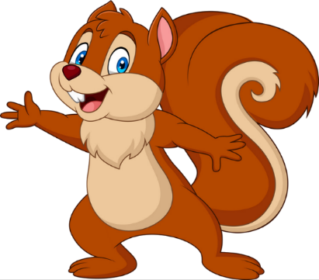
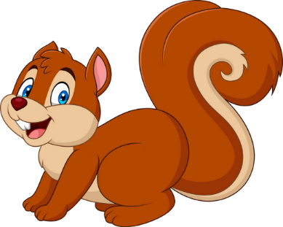
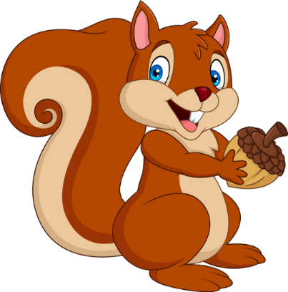


Facebook : Bùi Liễu
Mobile phone: 0968142780
PLAY
NEXT

Slide 5
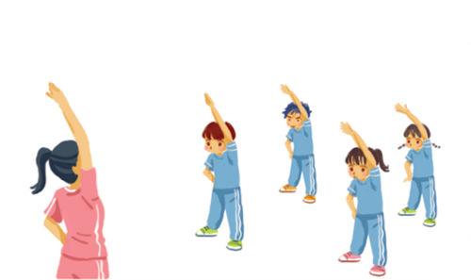


Facebook : Bùi Liễu
Mobile phone: 0968142780
A. IT
B. PE

Slide 6

A. IT
B. PE

Slide 7

A. English
B. Vietnamese

Slide 8

A. IT
B. maths
Facebook : Bùi Liễu
Mobile phone: 0968142780

Slide 9

A. art
B. PE

Slide 10

Facebook : Bùi Liễu
Mobile phone: 0968142780
A. art
B. music

Slide 11
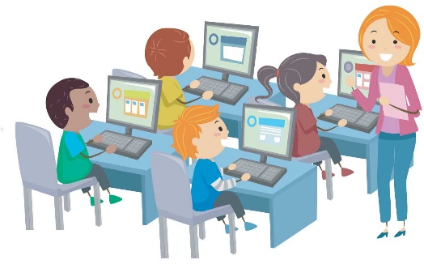
What’s your favourite subject?
A. It’s IT.
B. It’s maths.
Facebook : Bùi Liễu
Mobile phone: 0968142780

Slide 12
What’s your favourite subject?
A. It’s music.
B. It’s PE.

Slide 13

Mary: What’s your favourite _____?
Lucy: It’s maths.
A. subject
B. subjects
Facebook : Bùi Liễu
Mobile phone: 0968142780

Slide 14
Mary: _____ your favourite subject?
Lucy: It’s PE.
A. When’s
B. What’s

Slide 15


Good job!

Slide 16
Contents
01
02
03
04
05
06
Look, listen and repeat.
Listen, point and say.
Let’s talk.
Listen and number.
Look, complete and read.
Let’s play.

Slide 17

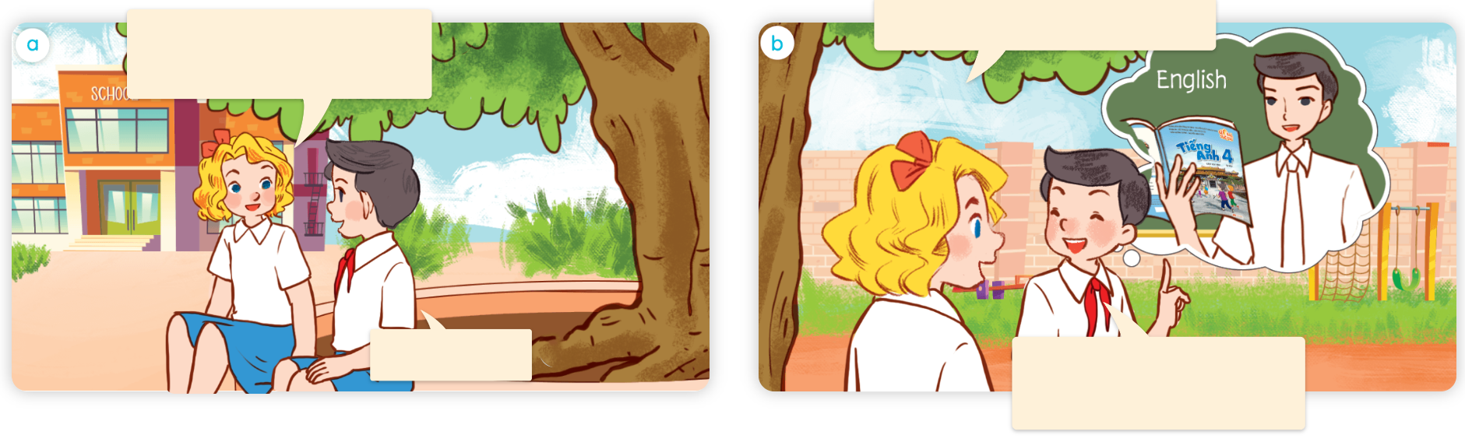
1. Look, listen and repeat.
Why do you like English?
What’s your favourite subject, Nam?
a
b
It’s English.
Because I want to be an English teacher.
Where are they?
What are they talking about?
Who are they?

Slide 18
Vocabulary

Slide 19
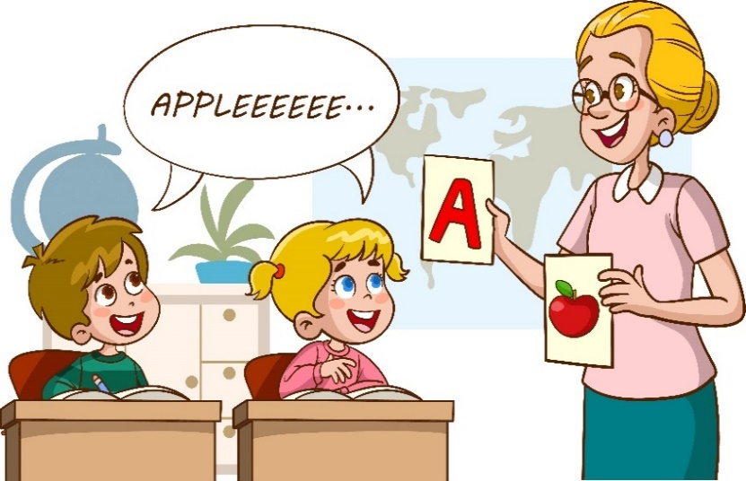
Vocabulary
English teacher
/ˈɪŋɡlɪʃ ˈtiːtʃə/
giáo viên Tiếng Anh

Slide 20
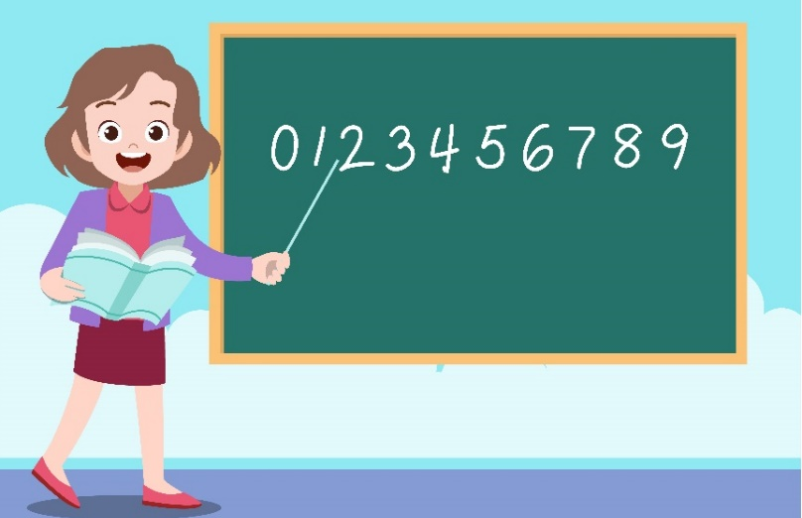
Vocabulary
maths teacher
/mæθsˈtiːtʃə/
giáo viên môn Toán

Slide 21
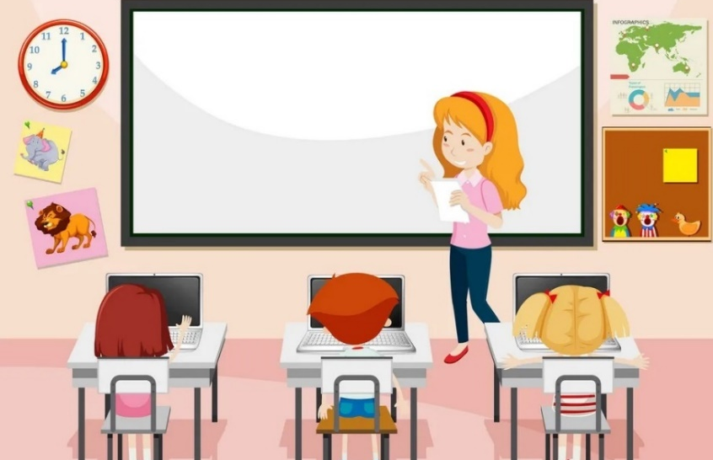
Vocabulary
IT teacher
/aɪ ˈtiːˈtiːtʃə/
giáo viên môn Tin học

Slide 22
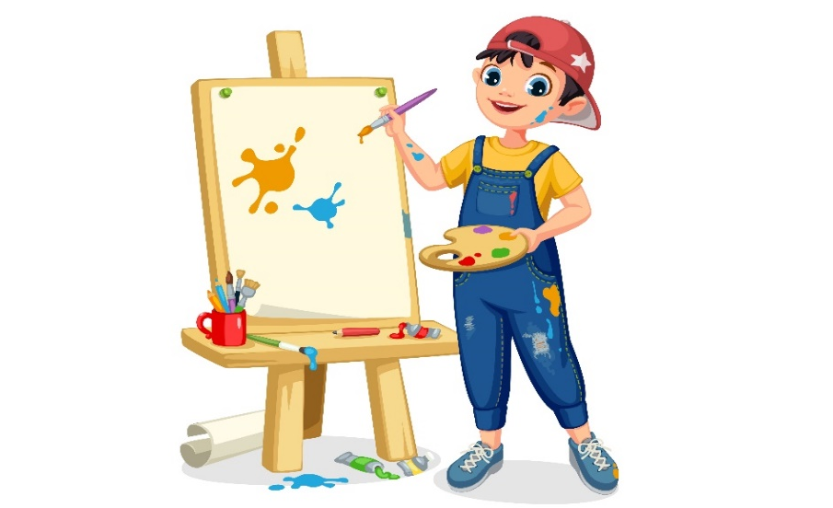
Vocabulary
painter
/ˈpeɪn.tər/
họa sĩ

Slide 23

Vocabulary
singer
/ˈsɪŋ.ər/
ca sĩ

Slide 24
Vocabulary
why
because
/waɪ/
/bɪˈkɒz/
tại sao
bởi vì

Slide 25
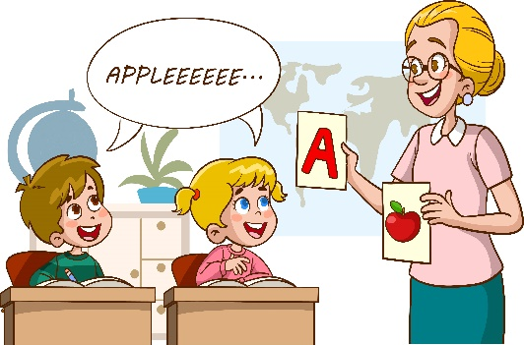
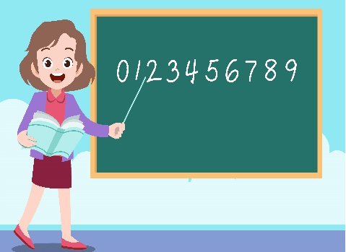


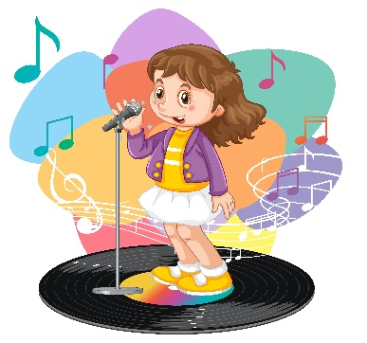
Review
English teacher
maths teacher
IT teacher
painter
singer
why
because

Slide 26
1. Vocabulary:
- English teacher
giáo viên Tiếng Anh
- maths teacher
giáo viên Toán
- IT teacher
giáo viên Tin học
- painter
họa sĩ
ca sĩ
- singer
- why
tại sao
- because
bởi vì

Slide 27
Match
Giáo viên Tiếng Anh
Giáo viên Tin học
tại sao
ca sĩ
bởi vì
họa sĩ
giáo viên toán
maths teacher
English teacher
IT teacher
singer
because
why
painter
Click on the clouds to show the answers.

Slide 28
Structures

Slide 29
2. Structure:
Hỏi “ lí do bạn thích môn học ”:
Why do you like English?
Because I want to be an English teacher.
Tại sao bạn lại thích môn tiếng Anh ?
Bởi vì tôi muốn trở thành giáo viên tiếng Anh.

Slide 30
Structures
Hỏi “ lí do bạn thích môn học ”:
Why do you like ________________?
Because I want to be ________________.
(Tại sao bạn lại thích ______ ?)
(Bởi vì tôi muốn trở thành __________)

Slide 31




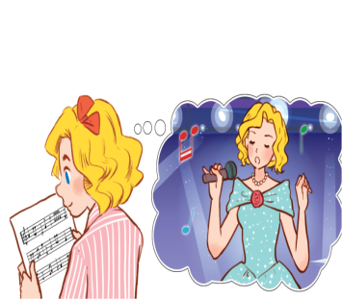
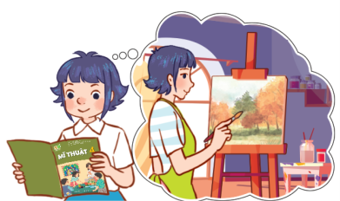
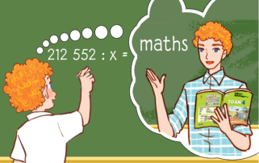
Unit 8 lesson 2
Why do you like ___________?
Because I want to be ________.
Facebook: Bùi Liễu
0968142780
English / an
English teacher
IT /
an IT teacher
music /
a singer
art /
a painter
Maths /
a maths teacher

Slide 32




2. Listen, point and say.
a
b
Chính chủ Facebook: Bùi Liễu
0968142780
Why do you like_____?
English / an English teacher
music / a singer
Because I want to be______.
c
d
maths / a maths teacher
art / a painter

Slide 33



2. Listen, point and say.
English / an English teacher
Why do you like English?
Because I want to be an English teacher.

Slide 34
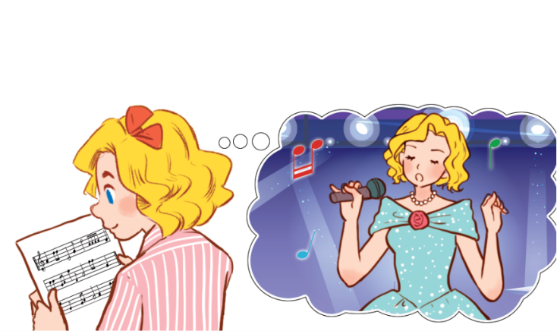
2. Listen, point and say.
music / a singer
Why do you like music?
Because I want to be a singer.

Slide 35

2. Listen, point and say.
art / a painter
Why do you like art?
Because I want to be a painter.

Slide 36

2. Listen, point and say.
maths / a maths teacher
Why do you like maths?
Because I want to be a maths teacher.

Slide 37
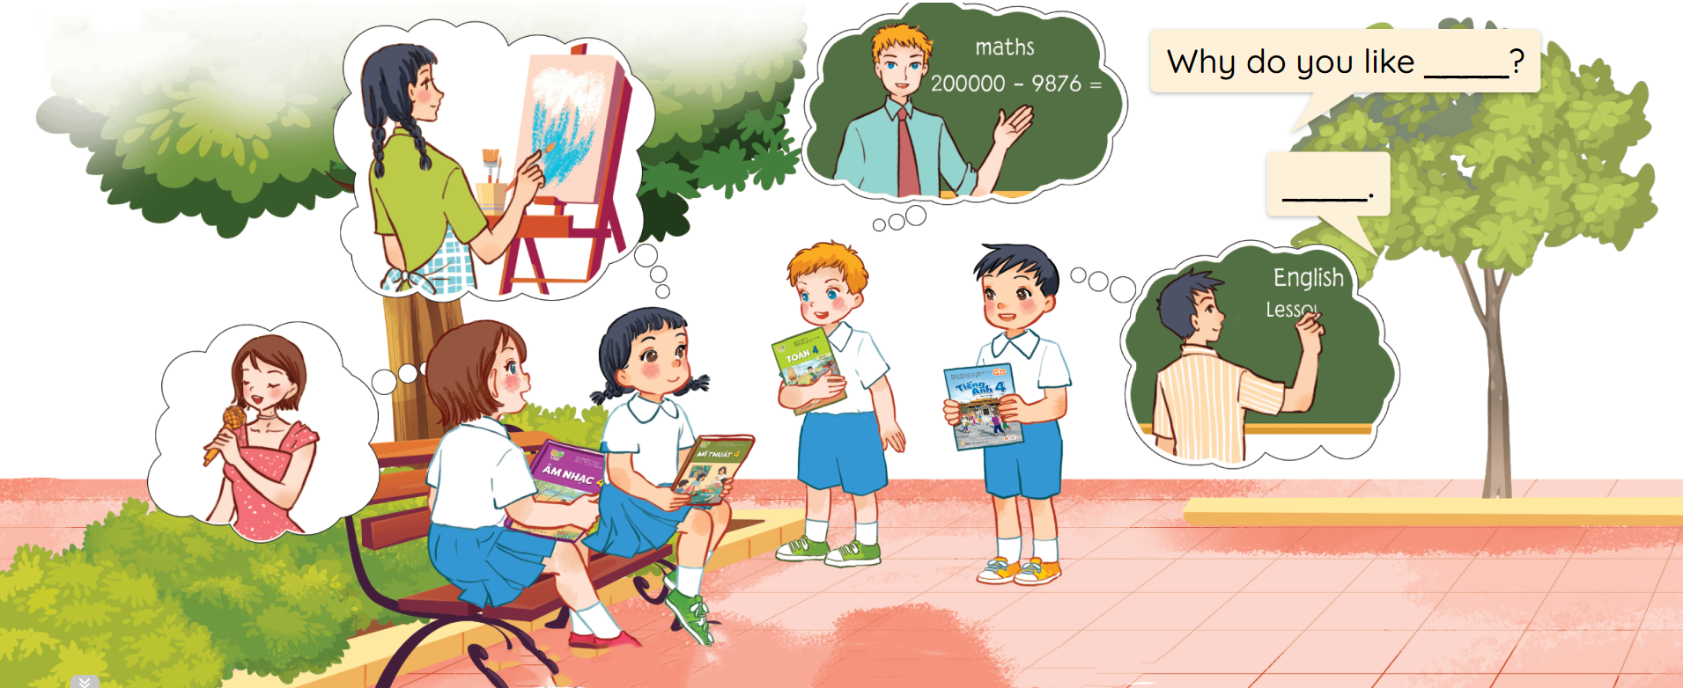
3. Let’s talk.

Slide 38
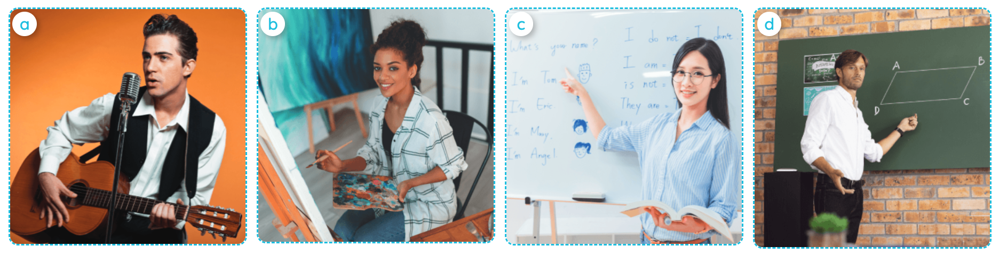




4. Listen and number.
a
b
c
d
3
1
4
2

Slide 39
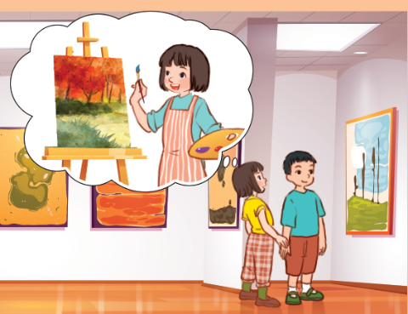
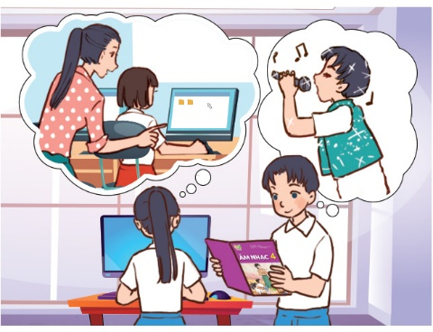
5. Look, complete and read.
1.
A: What’s your favourite subject?
B: It’s art. I like it.
A: _______ do you like art?
B: Because I want to be a ______.
Why
painter
2.
A: I like IT. It’s my favourite _______.
B: Why do you like it?
A: _______ I want to be an IT teacher.
How about you ?
B: My favourite subject is ________. I want to be a singer.
subject
Because
music

Slide 40
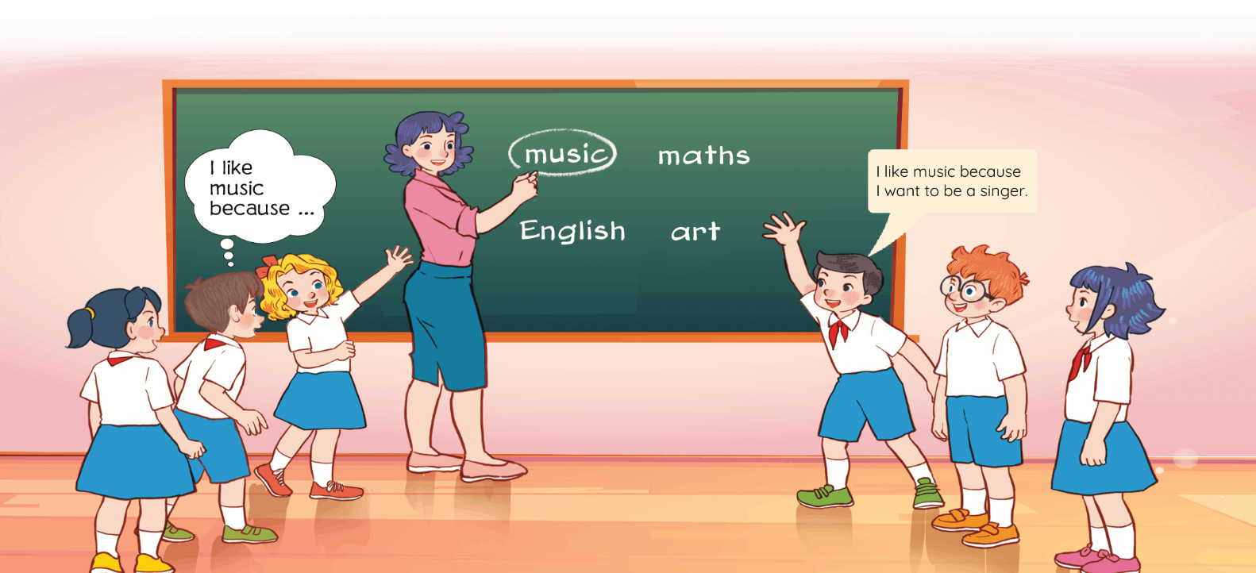
6. Let’s play.

Slide 41

Facebook : Bùi Liễu
0968142780
Let’s play!

Slide 42







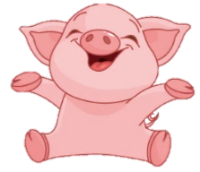
Facebook : Bùi Liễu
0968142780
Luật chơi:
Các đội lần lượt chọn các số từ 1-10.
Trả lời đúng được cộng, trả lời sai bị trừ số điểm đã mở.
Ngôi sao xanh được +200 điểm khi trả lời đúng, trả lời sai không bị trừ điểm
Ngôi sao đen bị -200 điểm khi trả lời sai, trả lời đúng không bị trừ điểm.
Lucky number
PLAY

Slide 43
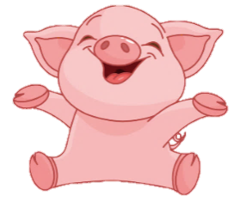


2
100
4
1
3
200
100
-200
Facebook : Bùi Liễu
0968142780
7
100
5
6
+200
200
8
100
9
10
100
200

Slide 44





Facebook : Bùi Liễu
0968142780
Back
A. painter
B. singer
C. IT teacher

Slide 45
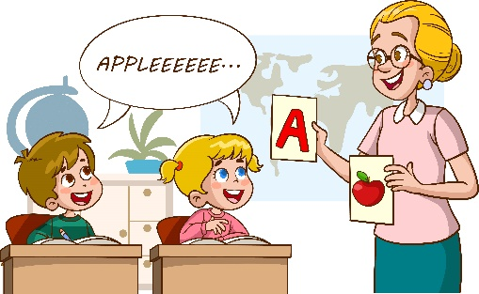
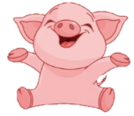
Back
A. English teacher
B. maths teacher

Slide 46

Back
A. singer
B. maths teacher
C. IT teacher

Slide 47
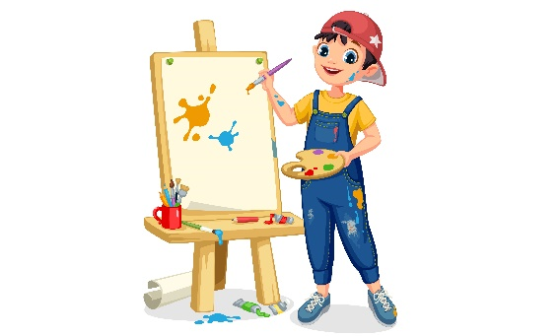
Back
A. teacher
B. painter

Slide 48
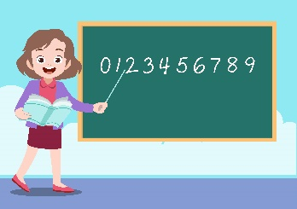


Back
A.
B.
C.

Slide 49
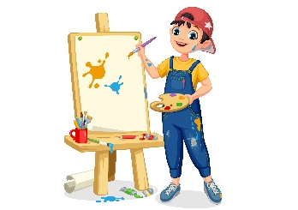
Back
A.
B.
C.

Slide 50

Back
A. English teacher
B. maths teacher

Slide 51

    ____ do you like English?
    Because I want to be an English teacher.
Back
A. When
B. Why

Slide 52
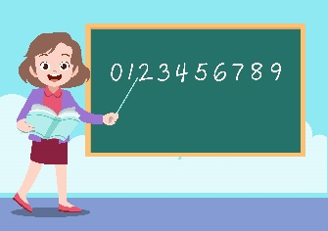
    A: Why do you like art?
    B: Because I want to be a painter.
Back
A.
B.
C.

Slide 53

    Why do you like maths?
    _____ I want to be a maths teacher.
Back
A. But
B. So
C. Because

Slide 54
Great!

Slide 55
Wrap up

Slide 56
Unit 8 lesson 2
Why do you like ___________?
Because I want to be ________.
English / an
English teacher
IT /
an IT teacher
music /
a singer
art /
a painter
Maths /
a maths teacher

Slide 57
Homework
Learn by heart all the new words.
Read again the dialogue in part 1.

Slide 58

Thank you!
Facebook: Bùi Liễu
0968142780

