Slide 2
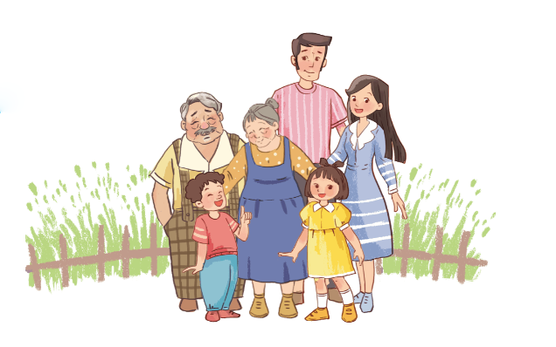
Facebook : Bùi Liễu
0968142780
Monday, December 10th 2023
Unit
13
APPEARANCE
Lesson 2

Slide 3
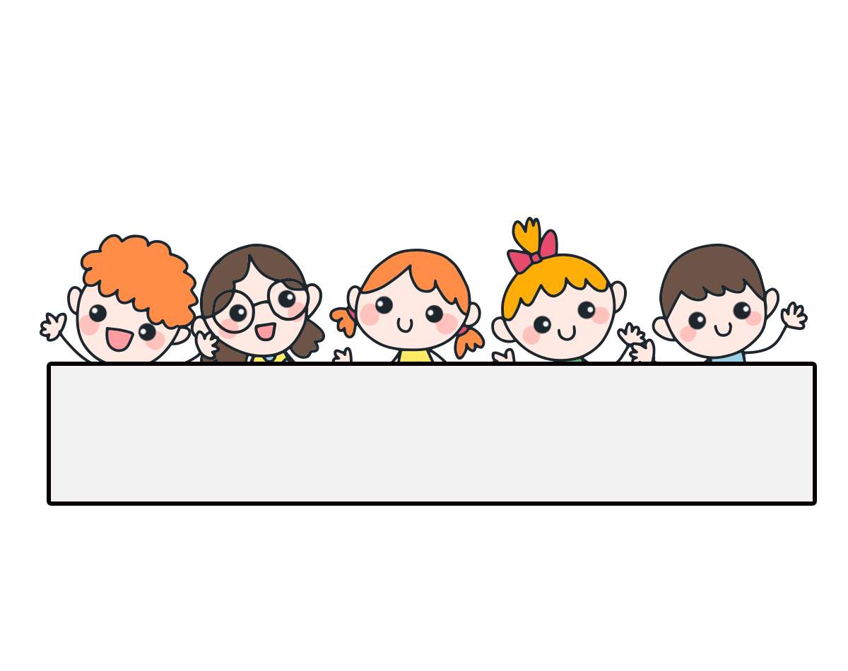
Warm-up

Slide 4
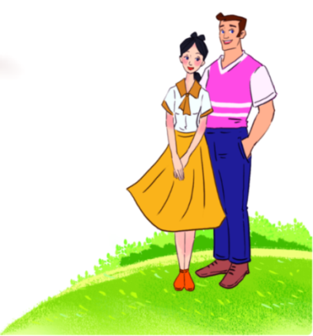
Let’s sing.
What do your parents look like?

Slide 5
Contents
Look, listen and repeat.
Listen, point and say.
Let’s talk.
Listen and number.
Look, complete and read.
Let’s play.

Slide 6
1. Look, listen and repeat.
What does he look like?
How old is your father, Mai?
a
b
He’s forty.
He has a round face.
What are they talking about?
Where are they?
Who are they?

Slide 7
Vocabulary

Slide 8
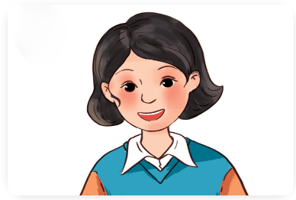
Vocabulary
short hair
/ʃɔːt heə/
tóc ngắn

Slide 9
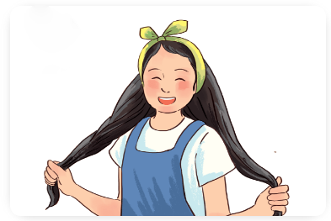
Vocabulary
long hair
/lɒŋ heə/
tóc dài

Slide 10
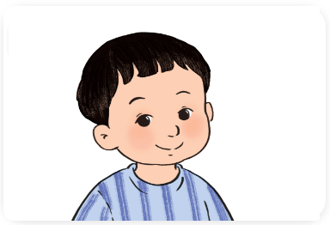
Vocabulary
round face
/raʊnd feɪs/
khuôn mặt tròn

Slide 11
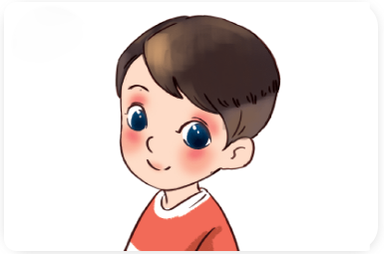
Vocabulary
big eyes
/bɪɡ aɪz/
đôi mắt to

Slide 12
Review
short hair
long hair
round face
big eyes

Slide 13
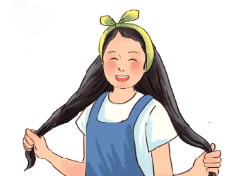
Vocabulary
1. short hair
: tóc ngắn
2. long hair
: tóc dài
3. round face
: khuôn mặt tròn
4. big eyes
: đôi mắt to

Slide 14
Match
1. round face
a. tóc dài
2. long hair
b. đôi mắt to
3. big eyes
c. khuôn mặt tròn
4. short hair
d. tóc ngắn

Slide 15
2. Listen, point and say.
a
b
What does he / she look like?
short hair
long hair
He / She has _______.
c
d
a round face
big eyes

Slide 16
2. Listen, point and say.
a
What does he / she look like?
He / She has _______.
short hair
What does she look like?
She has short hair.
Click on the sentences to listen.

Slide 17
2. Listen, point and say.
b
What does he / she look like?
He / She has _______.
long hair
What does she look like?
She has long hair.

Slide 18
2. Listen, point and say.
c
What does he / she look like?
He / She has _______.
a round face
What does he look like?
He has a round face.

Slide 19
2. Listen, point and say.
d
What does he / she look like?
He / She has _______.
big eyes
What does he look like?
He has big eyes.

Slide 20
Structures

Slide 21
Cách hỏi anh ấy, cô ấy trông như thế nào:
What does he / she look like?
( Anh ấy, cô ấy trông như thế nào?)
He / She has _______.
(Anh ấy / Cô ấy có _________.)
Ex:
What does he look like?
He has big eyes.

Slide 22
Unit 13 lesson 2
What does he / she look like?
He / She has ________.
short hair
big eyes
long hair
round face

Slide 23
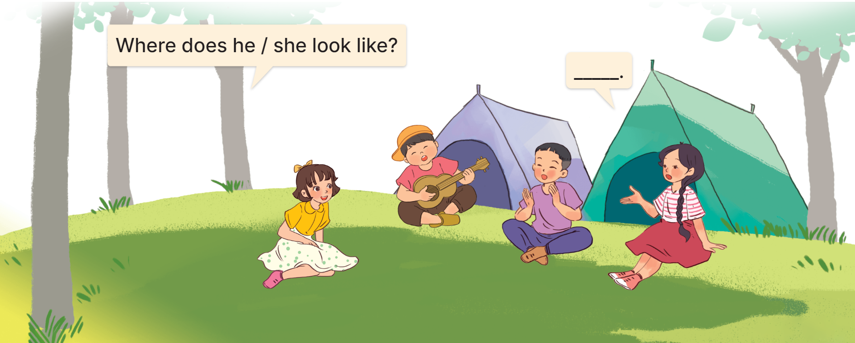
3. Let’s talk.

Slide 24
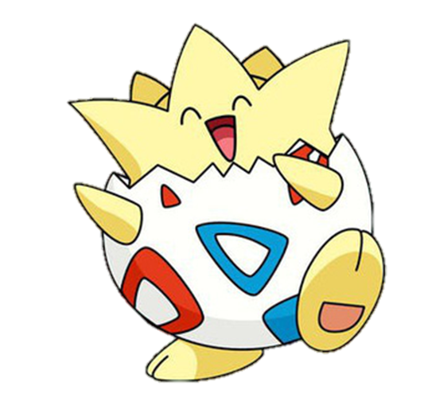
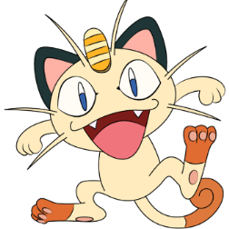
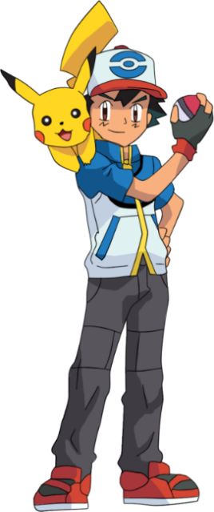
Warm-up

Slide 25
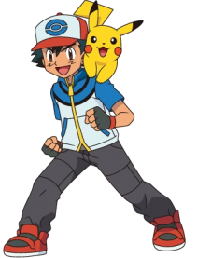
MsPham-0936082789
MsPham-0936082789
MsPham-0936082789
MsPham-0936082789

Slide 26
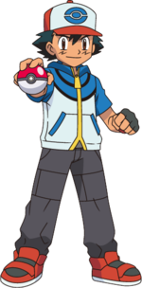
2
______ hair.
A. long
B. short
C. round

Slide 27
_______ face
A. short
B. round
C. big

Slide 28
2
_____ eyes
A. big
B. long
C. round

Slide 29
A: What does he look like?
B: _______________.
A. He has long hair.
B. She has a round face.
C. He has a round face.

Slide 30
A: What does she look like?
B: _______________.
A. He has big eyes.
B. She has short hair.
C. She has long hair.

Slide 31
A: What does he look like?
B: _______________.
A. He has big eyes.
B. It’s a big city.
C. He works at a hospital.

Slide 32
A.
B.
C.
Click on the letter A, B or C to choose the answer.

Slide 33
A.
B.
C.

Slide 34
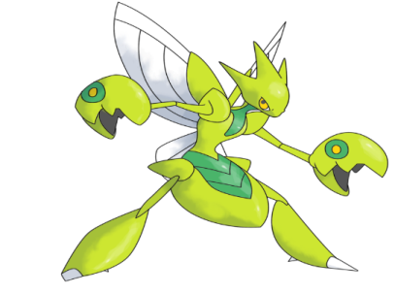
A.
B.
C.

Slide 35
A.
B.
C.

Slide 36
Welldone!

Slide 37
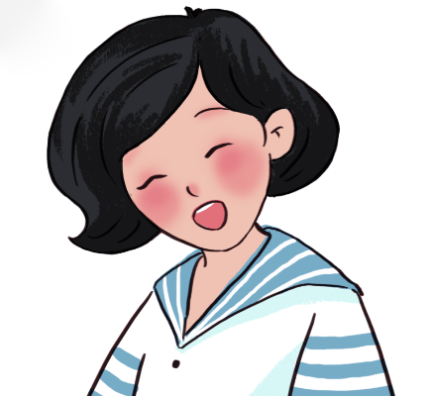
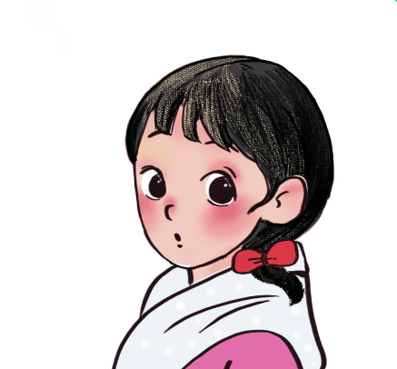
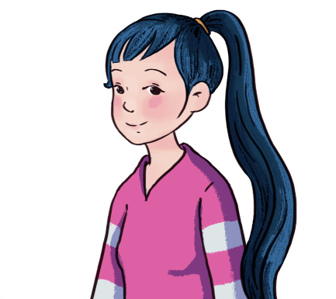
4. Listen and number.
a
b
c
d
2
4
3
1

Slide 38
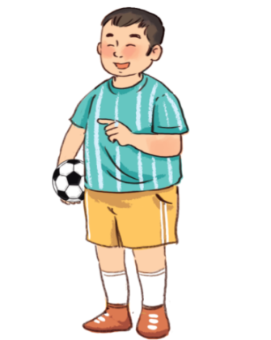
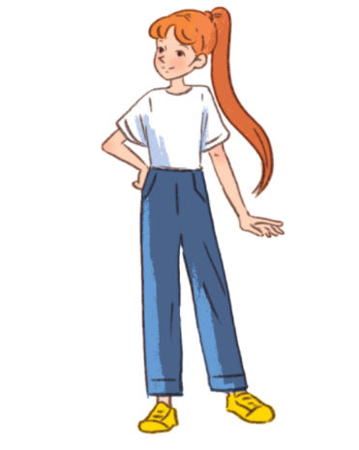
5. Look, complete and read.
1.
A: Do you have a brother, Mai?
B: Yes, I do.
A: What does he look like?
B: He’s _________. He has a round _____.
big / short
face
2.
A: Do you have a sister, Bill?
B: Yes, I do.
A: What does she _____________?
B: She’s slim. She has ____________.
look like
long hair

Slide 39
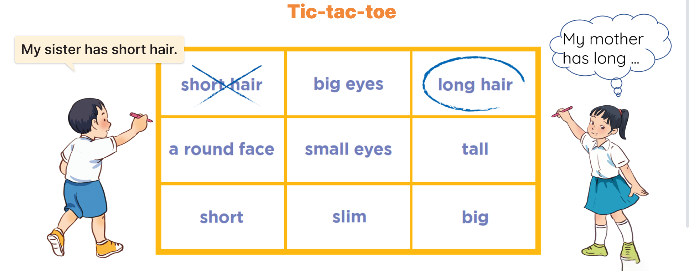
6. Let’s play.

Slide 40
Play game!

Slide 41
Question 1
10
9
8
7
6
5
4
3
2
1
0
A.
B.
C.
Nhấn vào “play” để xuất hiện 3 đáp án và xuất hiện đồng hồ đếm ngược 10 giây. Hết 10 giây suy nghĩ, sẽ xuất hiện dấu “???”. GV nhấn vào “???” để hiển thị đán án đúng. Nhấn “next” để chuyển tới câu khác.

Slide 42
Question 2
10
9
8
7
6
5
4
3
2
1
0
A.
B.
C.

Slide 43
Question 3
10
9
8
7
6
5
4
3
2
1
0
A.
B.
C.

Slide 44
Question 4
10
9
8
7
6
5
4
3
2
1
0
What does he look like?
A. She has big eyes.
B. He has a round face.
C. He has short hair.

Slide 45
Question 5
10
9
8
7
6
5
4
3
2
1
0
___ eyes
A. round
B. small
C. big

Slide 46
Question 6
10
9
8
7
6
5
4
3
2
1
0
____ hair
A. long
B. big
C. short

Slide 47
Question 7
10
9
8
7
6
5
4
3
2
1
0
A. short hair
Choose the odd one out:
B. father
C. round face

Slide 48
Question 8
10
9
8
7
6
5
4
3
2
1
0
A. street
Choose the odd one out:
B. long hair
C. road

Slide 49
Question 9
10
9
8
7
6
5
4
3
2
1
0
A. What does she look like?
A: ____________
B: He has big eyes.
B. What does he look like?
C. Where do you live?

Slide 50
Question 10
10
9
8
7
6
5
4
3
2
1
0
She has long hair.
A. False
B. True

Slide 51
Click on the bell.

Slide 52
Wrap up

Slide 53
Unit 13 lesson 2
What does he / she look like?
He / She has ________.
short hair
big eyes
long hair
round face

Slide 54
Homework
Learn by heart all the new words.
Read again the dialogue in part 1.

Slide 55
Thank you!

